Slide 1
Theory of Automata (CSC- 402) Semester : Spring 2026 Credit Hours: 3

Slide 2
Theory of Automata Course
Lecture 8

Slide 3
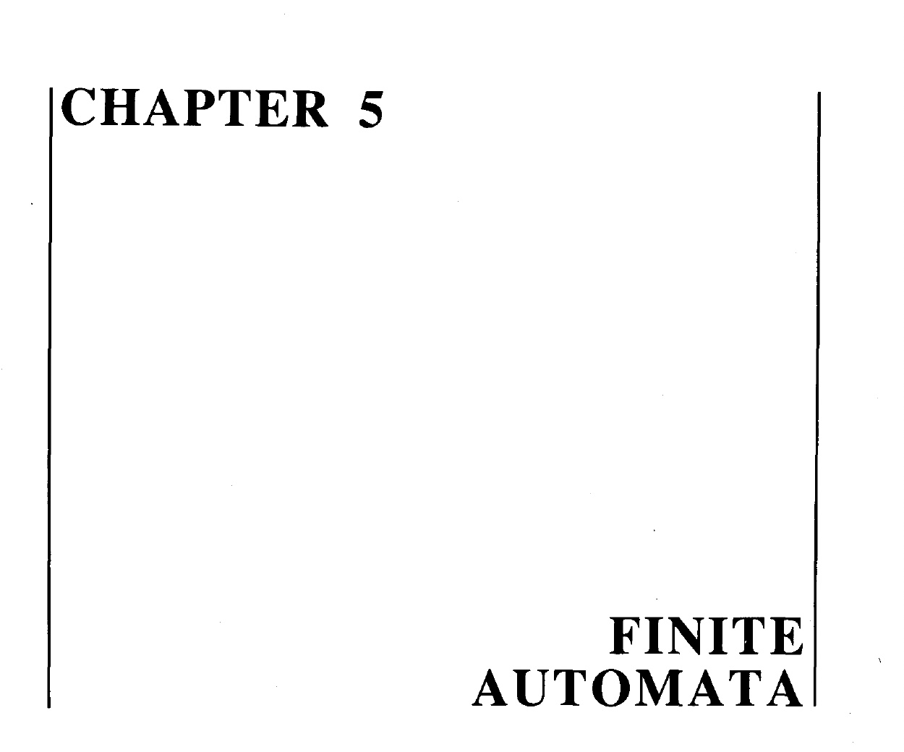

Slide 4
TASK
Build an FA for the language L of strings, defined over Σ={a, b}, of odd length.
Solution:The language L may be expressed by RE (a+b)((a+b)(a+b))* or ((a+b)(a+b))*(a+b)
This language may be accepted by the following FA

Slide 5
Solution continued …
a,b
1 –
2 +
a,b

Slide 6
Task
Build an FA accepting the Language L of Strings, defined over Σ = {a, b}, beginning with and ending in same letters.
Solution:The language L may be expressed by the following regular expression
(a+b)+a(a + b)*a + b(a + b)*b
This language L may be accepted by the following FA

Slide 7
Solution continued …
a
b
a
a
b
4
6+
2+
a
b
1–
b
a
b
b
b
a
7+
3+
5
a

Slide 8
Example
Consider the Language L of Strings , defined over Σ = {a, b}, beginning with and ending in different letters.
The language L may be expressed by the following regular expression
a (a + b)* b + b (a + b)* a
This language may be accepted by the following FA

Slide 9
Example Continued …
a
b
b
2
4+
a
a
1–
b
a
a
b
5+
3
b

Slide 10
Example
Consider the Language L , defined over Σ = {a, b} of all strings including Λ, The language L may be accepted by the following FA
The language L may also be accepted by the following FA
a,b
1±
a,b
2+

Slide 11
Example Continued …
a,b
The language L may be expressed by the following regular expression
(a + b)*
±

Slide 12
Example
Consider the Language L , defined over Σ = {a, b} of all non empty strings. The language L may be accepted by the following FA
The above language may be expressed by the following regular expression (a + b)⁺
a,b
–
a,b
+

Slide 13
Example
Consider the following FA, defined over Σ = {a, b}
It is to be noted that the above FA does not accept any string. Even it does not accept the null string. As there is no path starting from initial state and ending in final state.
a,b
–
a,b
+

Slide 14
Equivalent FAs
It is to be noted that two FAs are said to be equivalent, if they accept the same language, as shown in the following FAs.

Slide 15
Equivalent FAs Continued …
a,b
FA₁
FA₂
FA₃
–
a,b
+
a,b
1–
a,b
2
a,b
a,b
1–
a,b
2
3+

Slide 16
Example
Consider the Language L of strings , defined over Σ = {a, b}, containing double a.
The language L may be expressed by the following regular expression
(a+b)* (aa) (a+b)*. This language may be accepted by the following FA

Slide 17
Example Continued …
b
a,b
a
2
a
1-
3+
b

Slide 18
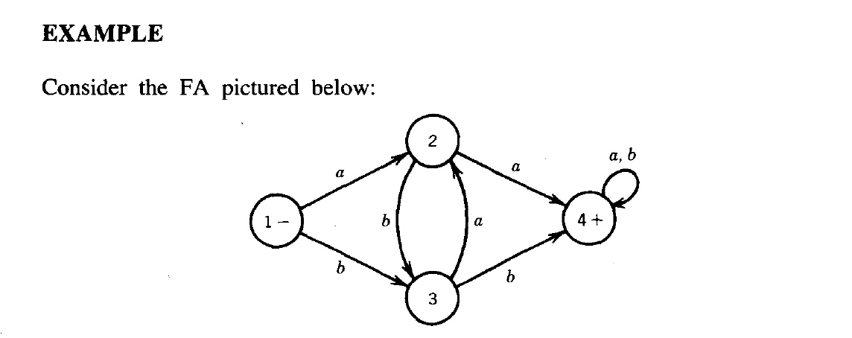
Example

Slide 19
Make a transition table of this?
Write a regular expression for this FA

Slide 20
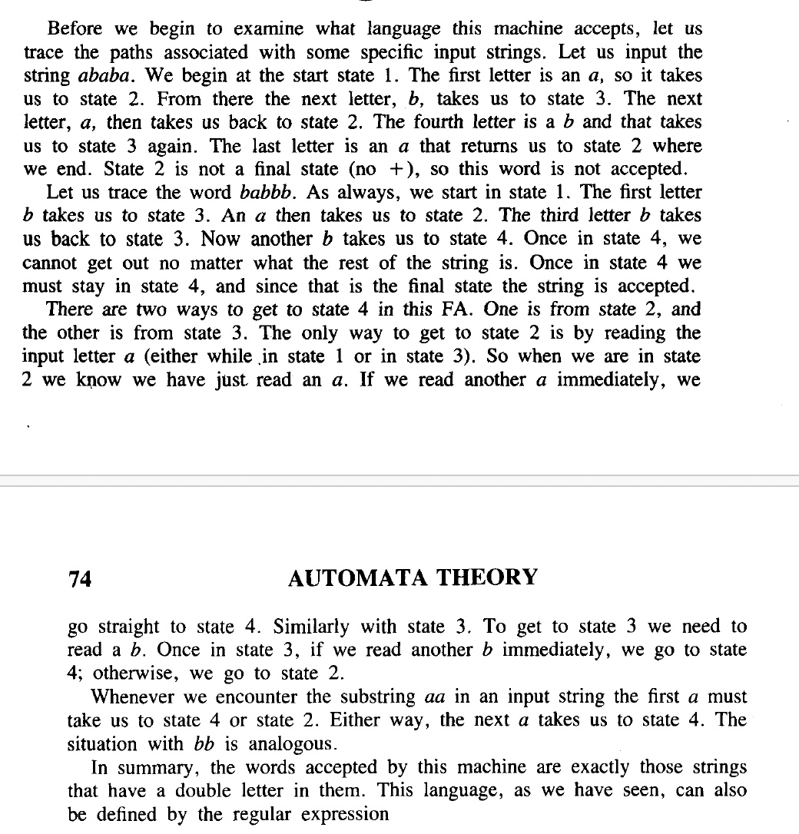

Slide 21

Regular expression

Slide 22
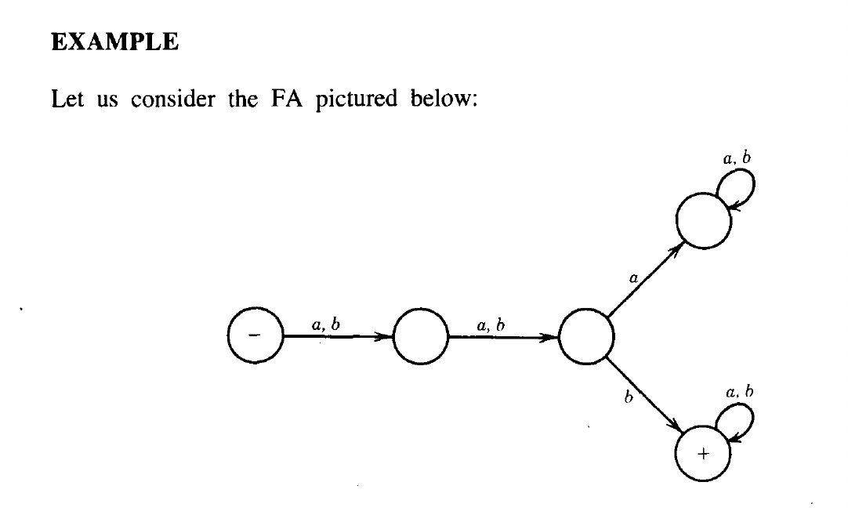
Write down the regular expression for the following finite automata

Slide 23
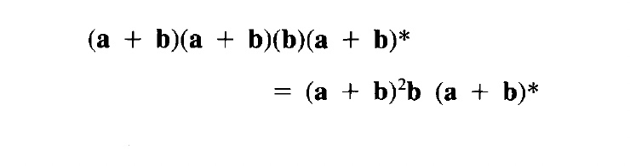
Solution

Slide 24
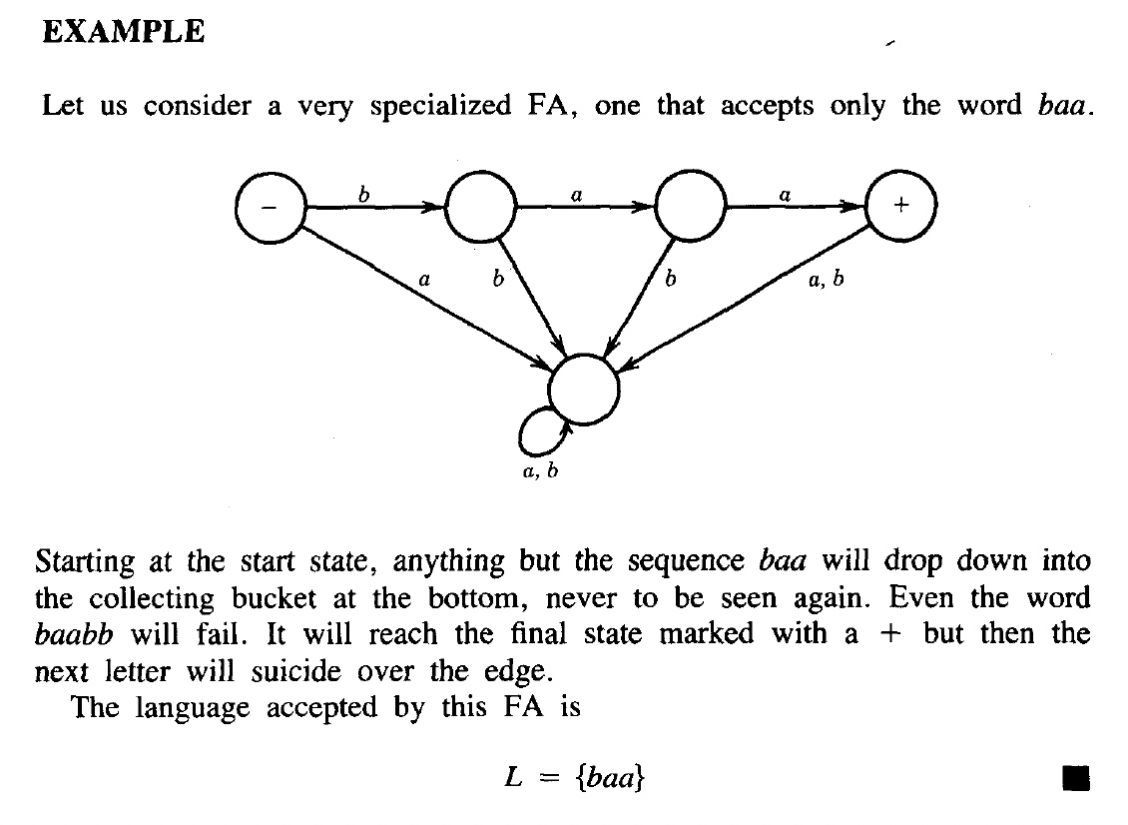

Slide 26
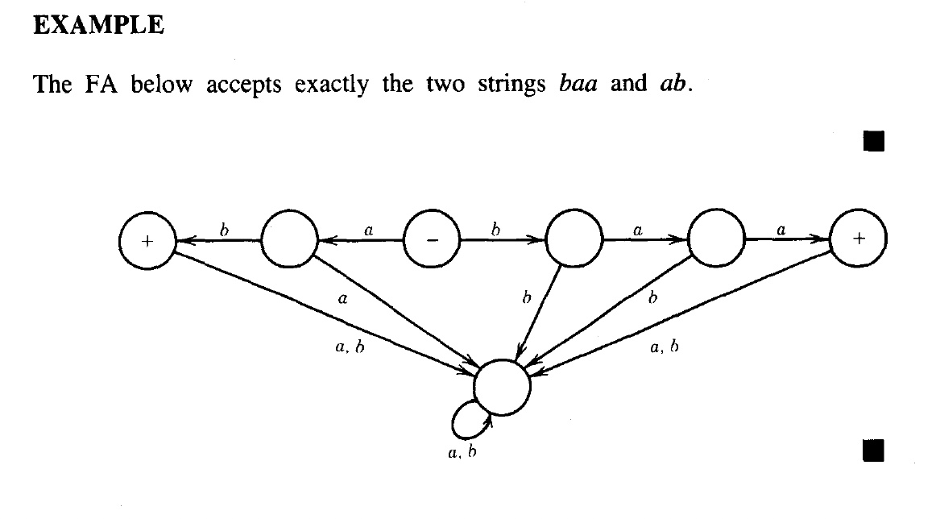
Write down the regular expression for the following

Slide 27
Write down the regular expression for the following

Slide 28
Solution
The regular expression for the previous machine is:
(ab+baa)

Slide 29
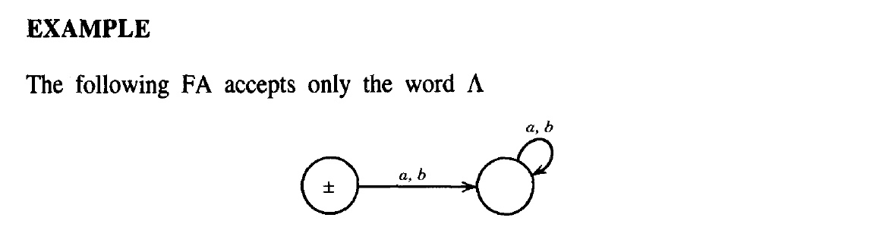

Slide 31
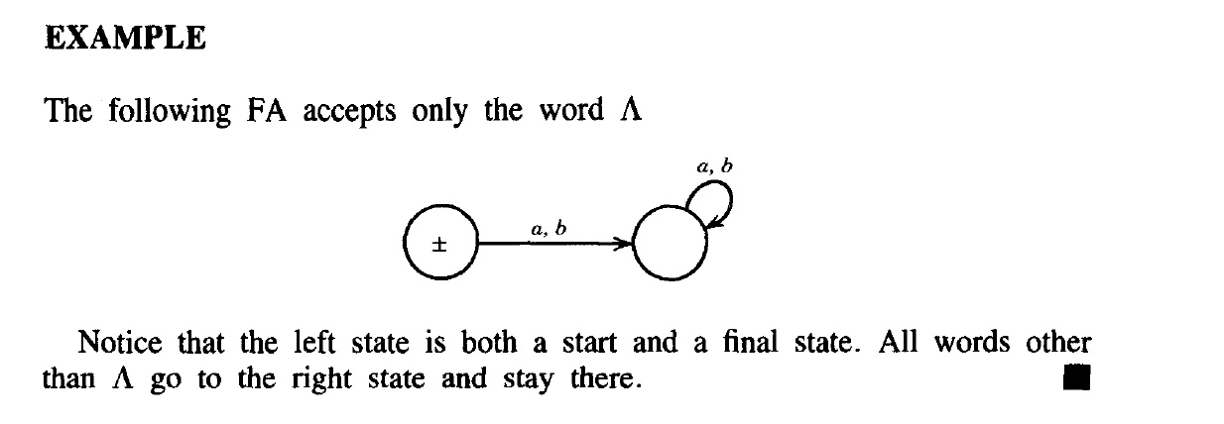
Solution

Slide 32
Example
Consider the language L of strings, defined over Σ={a, b}, having triple a’s or triple b’s. The language L may be expressed by RE
(a+b)* (aaa + bbb) (a+b)*
This language may be accepted by the following FA

Slide 33
Example Continued …
2
a
4
a
a
b
a,b
1––
a
b
6+
b
a
b
3
b
5

Slide 34
Example
Consider the EVEN-EVEN language, defined over Σ={a, b}. As discussed earlier that EVEN-EVEN language can be expressed by the regular expression (aa+bb+(ab+ba)(aa+bb)*(ab+ba))*
EVEN-EVEN language may be accepted by the following FA

Slide 35
Example Continued …
b
1±
3
b
a
a
a
a
b
2
4
b

Slide 36
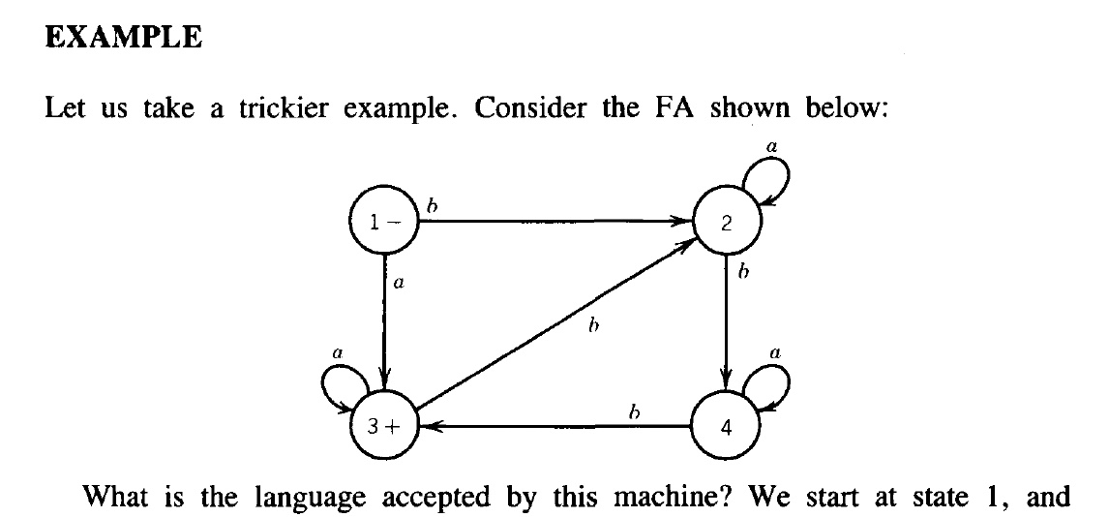
Notes:
RE..... FA....TG ------
.......FA.... DFA------ Moore and Mealay Machines
.......FA.....NFA -----

Slide 37
Make a transition table
Write down its regular expression

Slide 38
End of Lecture

